Slide 1

CAREER GUIDANCE WEBSITE FOR STUDENTS
DEPARTMENT OF COMPUTER SCIENCE AND ENGINEERING
GE19612-PROFESSIONAL READINESS FOR INNVOATION, EMPLOYABILITY AND ENTREPRENEURSHIP
Dr. T. KUMARAKURUBARAN
ABITHA M - 210701011
ADITI S - 210701016
PROFESSOR

Slide 2
ABSTRACT
The Career Guidance website is an innovative platform designed to bridge the gap between students seeking career opportunities and administrators providing valuable internships and workshops. The website features two distinct logins: a student login and an admin login. Through the admin login, administrators can efficiently post current internships and workshops, ensuring that all relevant opportunities are readily available to students. Students, using their dedicated login, can create personalized profiles by uploading their name, age, interests, and resumes. Additionally, students have access to a user-friendly search function to explore and apply for internships that align with their career goals. This streamlined system facilitates a seamless connection between students eager to gain practical experience and administrators looking to fill internship positions with motivated and qualified candidates.

Slide 3
EXISTING SYSTEM
Intern-shala:
Intern-shala is a popular online platform focused on internships. It allows students to search and apply for internships across various fields. Students can create profiles, upload resumes, and receive internship recommendations based on their interests and skills.
Lets-Intern:
Lets-Intern connects students with internship opportunities across diverse industries. It enables students to create profiles, upload resumes, and apply for internships directly.

Slide 4
PROPOSED SYSTEM
The proposed system is a career guidance website with separate logins for students and administrators. Administrators can post internships and workshops, while students can upload their details and apply for these opportunities. It streamlines the process of finding and applying for career-building experiences, benefiting both students and administrators.
This platform offers a user-friendly interface for administrators to manage postings and for students to explore and apply for internships and workshops tailored to their interests and qualifications. With efficient features such as filtering options and online application submission, it enhances the overall experience of career exploration and professional development for students while simplifying the administrative tasks involved in managing such opportunities.

Slide 5





ADVANTAGES OF PROPOSED SYSTEM
EFFECIENCY
Streamlines the internship and workshop management process.
TIME SAVING
Saves time for both students and administrators in the application process.
ENHANCED MATCHING
Matches students with relevant opportunities based on their interests
ACCESSIBILITY
Provides easy access to opportunities for students
TRANSPARENCY
Offers clear information about opportunities, requirements, and deadlines

Slide 6

MODULES
There are two modules in the proposed career guidance app.
STUDENT MODULE
ADMIN MODULE

Slide 7
MODULE DESCRIPTION
STUDENT MODULE
ADMIN MODULE
Profile Creation: Students create detailed profiles with personal and academic information.
Resume Upload: Capability to upload resumes showcasing qualifications.
Interest Matching: Algorithms match student profiles with relevant opportunities.
Search and Filter: Students can search and filter opportunities based on various criteria.
Application Submission: Apply for opportunities directly through the platform.
Application Tracking: Ability to track application status.
Opportunity Posting: Ability to post details about internships and workshops, including descriptions, requirements, and deadlines.
Editing and Updating: Admins can edit and update posted opportunities as needed, ensuring accuracy and relevance.
Application Management: Review and manage student applications, including screening, shortlisting, and accepting/rejecting applicants.
User Management: Manage student accounts, including registration, profile updates, and access control.

Slide 8
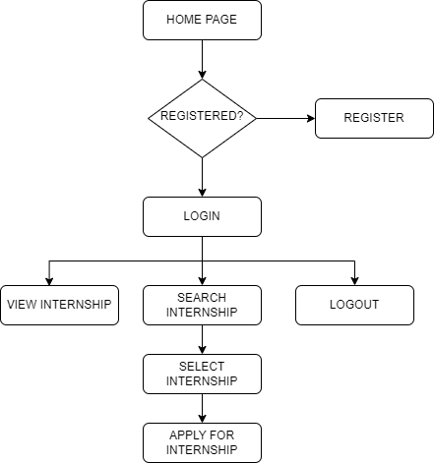
FLOW DIAGRAM

Slide 9
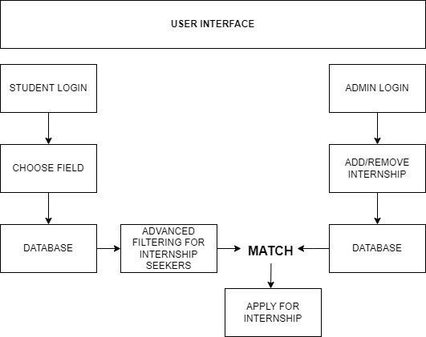
ARCHITECTURE DIAGRAM

Slide 10
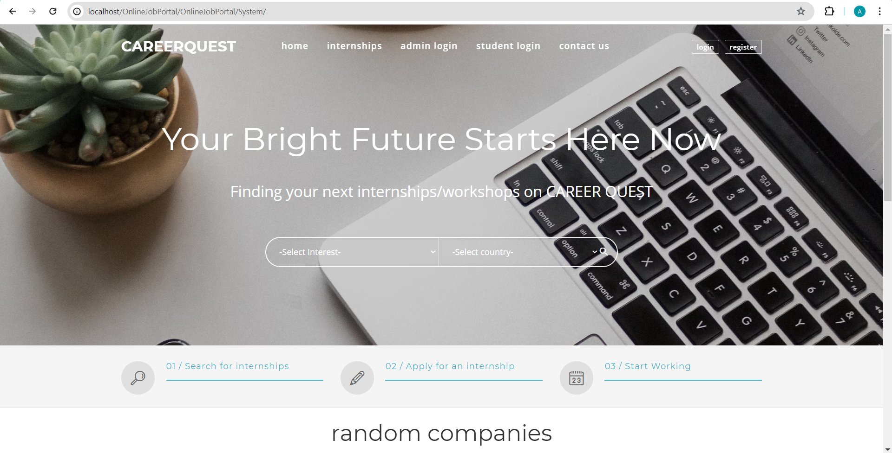
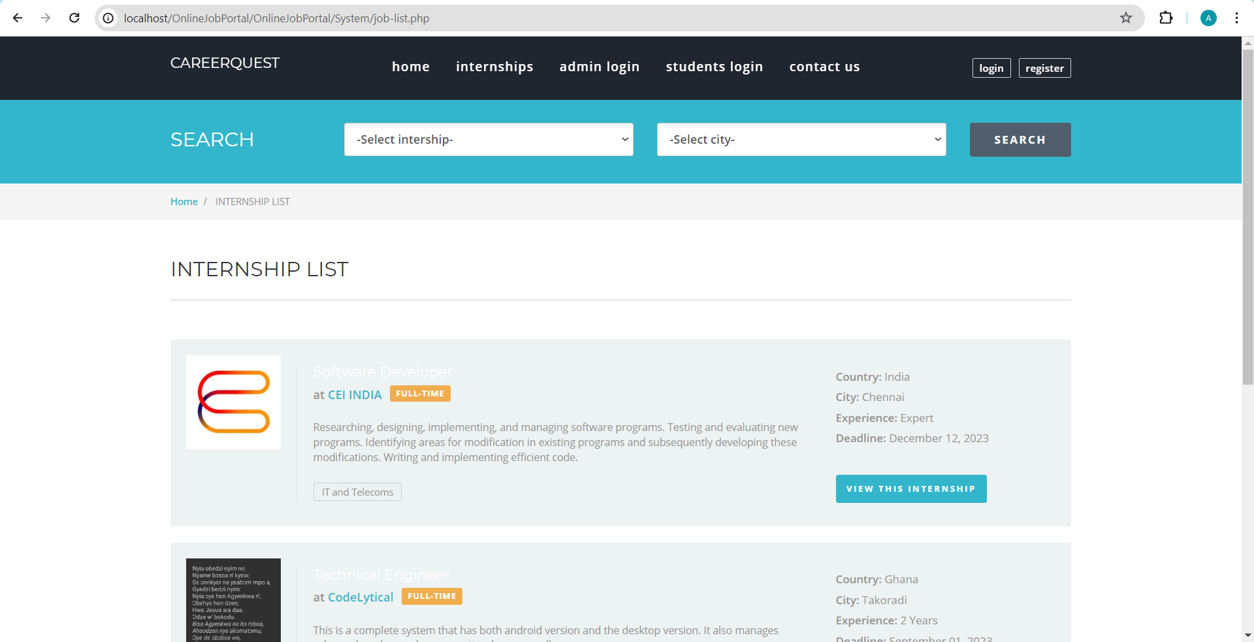
OUTPUT

Slide 11
Thank You

